Slide 1
Project Name:- Vision to support Visually Impaired people Team Name:- Electric Eye team leader:- Fauzail Karnar
Members:- Sachin Rai, Kshitij Jande, Viraj Garg

Slide 2
Why this project?
Eyes are the most important organ of the body, and transmits 83% of the information from the surroundings.
According to survey in 11 October, 2017, about 253 million have vision issues, where 36 million are totally blind, and 2017 million people have severe vision impairment.
Electric Eye is a device, specially designed for visually impaired people, allowing them to interpret their surroundings, and keeping themselves safe from the dangers and obstacles nearby.

Slide 3
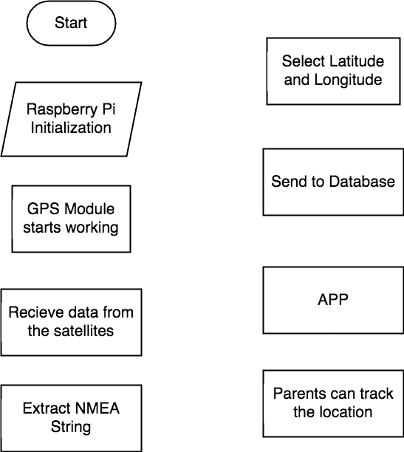
Solution :-
This system was designed comprising a walking stick and an app, where the control kernel is performed by Raspberry PI.
As the walking stick is embedded with two ultrasonic sensors, it can detect obstacles at the ground level, as well as for upper body parts.
This device has a face recognizer which has the ability to recognize family members or known people and all the data stored in the database.
The created app is useful for parents tracking user location, and the emergency app is very useful for the user in panic situations.
Thus, ultimately this could increase the confidence level of the user as well as make him/her feel secure.
Basic Flowchart Idea
(Concept)

Slide 4
Unique Selling Points :-
As visually impaired people face many difficulties, they are unable to do daily life activities, and to travel anywhere they wish to, so this device will definitely help reduce their problems, and make their life easier.
As visually impaired people face problems while recognizing family members, relative and known people, our device can help to recognize them in a correct way, because our device has an ability to recognize faces, and stores people’s data in the database and can read/recognize them though face recognizer.
As our device contains GPS module from which parents can monitor the Visually Impaired Person through a tracking option present in the device.

Slide 5
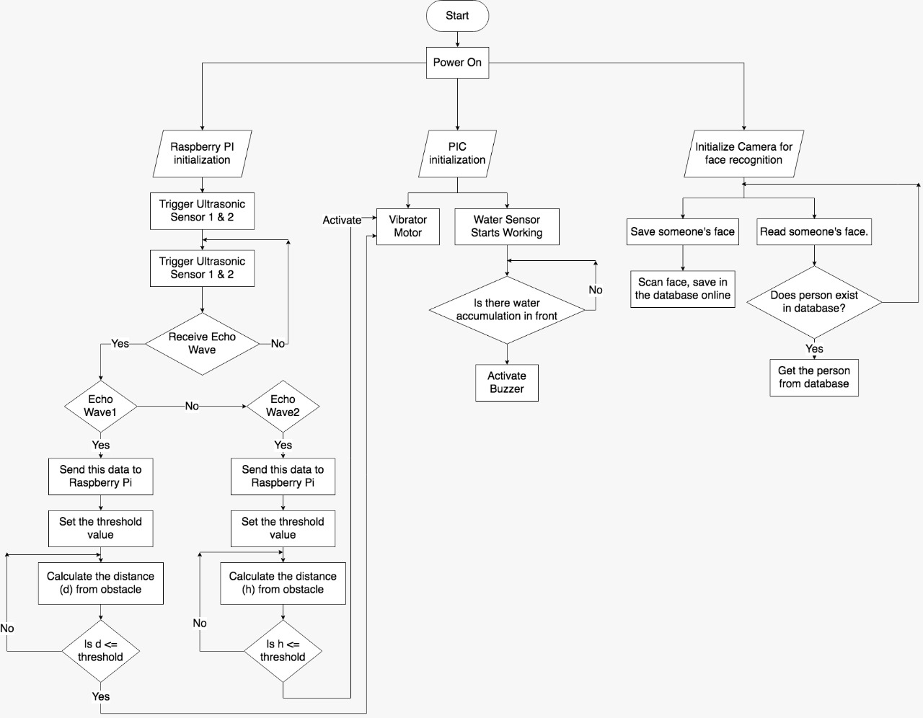
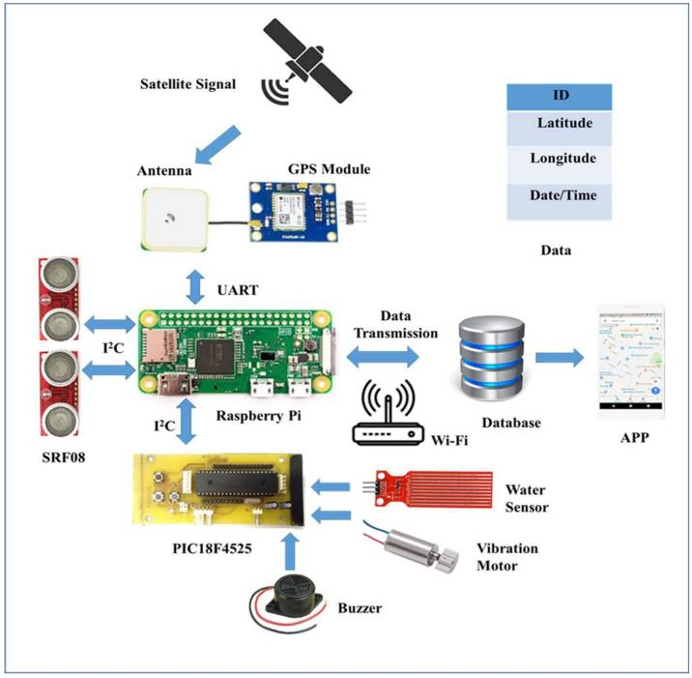
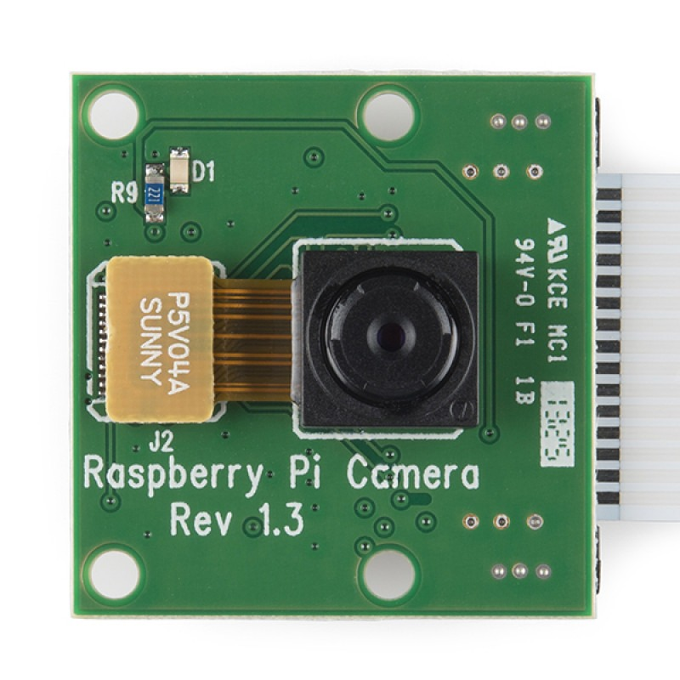
Architecture :-
Camera (Face Recognizer)

Slide 6
Used Technologies and sub-components :-
Raspberry Pi W :wireless LAN and Bluetooth, the Raspberry Pi Zero W is ideal for making embedded Internet of Things (IoT) projects. -Rs 2,500
PIC Microcontroller : It is controlled by software and programmed in such a way that it performs different tasks and controls a generation line. - PIC18F4525 Rs 500
2 Ultrasonic Sensor: ultrasonic sensors, use high frequency sound waves to resonate a desired frequency and convert electric energy into acoustic energy, and vice versa. - SRF08 Rs 5,302
Water Level sensor : Level sensors are used to detect the level of substances that can flow.- REES52 Rs 100
GPS GY-NEO6MV2 Module : GPS receivers are generally used in smartphones, fleet management system, military etc. for tracking or finding location. Rs 2000
Vibrating Motor :To send vibration to person using device which indicates that some obstacles are there Rs 40
Buzzer :We used this device to alert a person about the water level- Rs 100
RASPBERRY PI CAMERA MODULE WITH CABLE 5MP :used for recognition of face- Rs 410

Slide 7
Future Scope :-
Our goal is to give vision to visually impaired people. As our project is based on data driven device under health and medical conditions which in future can help those who are visually impaired to do daily activities in a better and a correct way.
Extra long time for Alpha/Beta testing until device is completely functional with least possible minor bugs.
Constantly working on the code and algorithm, making it better, faster and reliable.
Come up with new ideas that will be extremely helpful for people using the device and making it a best device for them.
Constantly monitor the system, and keep checking for faults and problems in the system, and fixing them as soon as possible.

Slide 8


